Slide 1
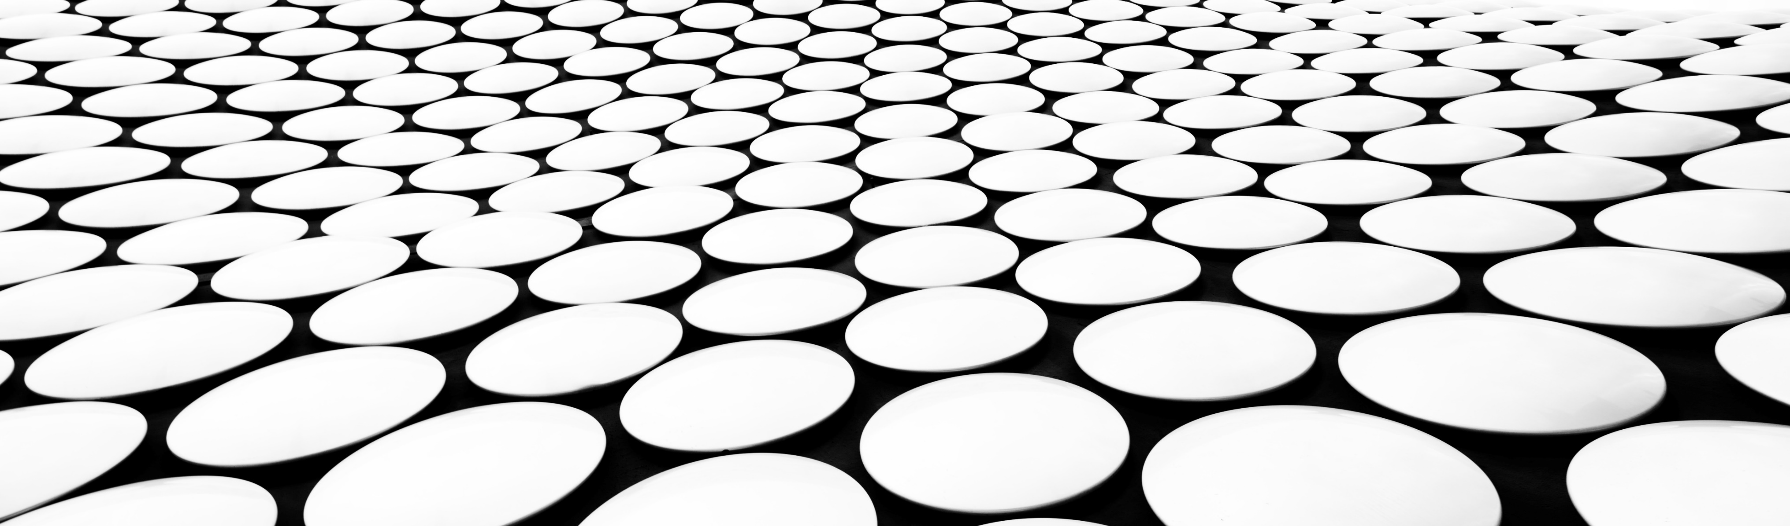
Presentation for Ph.D Application
Jingyuan Sha

Slide 2
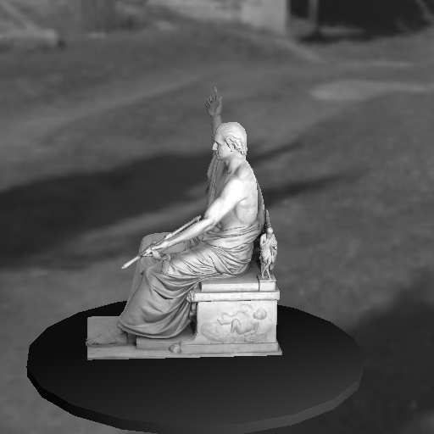
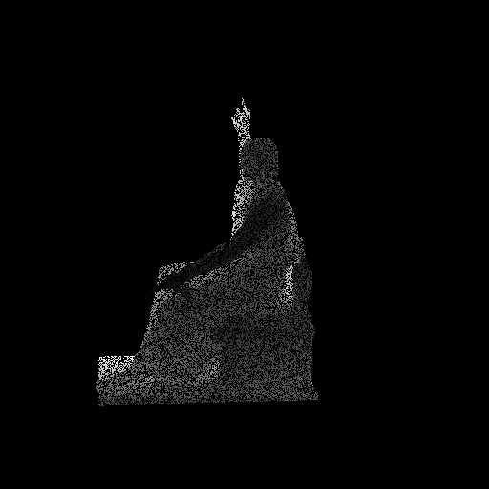
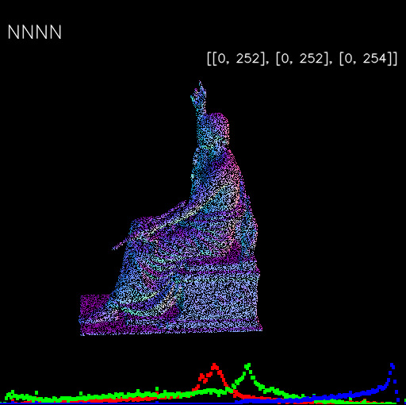

Improved Normal Inference from Calibrated illuminated RGB-d images
Standard method compute normal from point cloud using neighboring information or use Shape from shading
Grayscale image
Depth Map (semi-dense) , and known calibration
→point cloud or vertex map
Normal Map (semi-dense)
Normal Map are only semi-dense, if mapped on mesh (dense), that is not good at all
Dependent on chose neighbor size. If it is too small, → noise sensitive, If too large → too smooth and not crispy

Slide 3
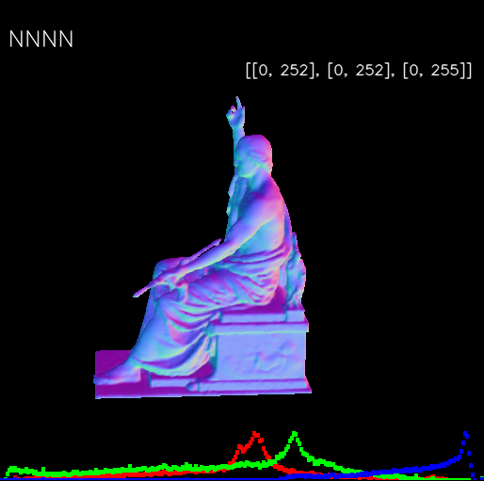
Improved Normal Inference from Calibrated illuminated RGB-d images
Grayscale image
Depth Map (semi-dense) , and known calibration
→point cloud or vertex map
Normal Map (fully dense)

Slide 4
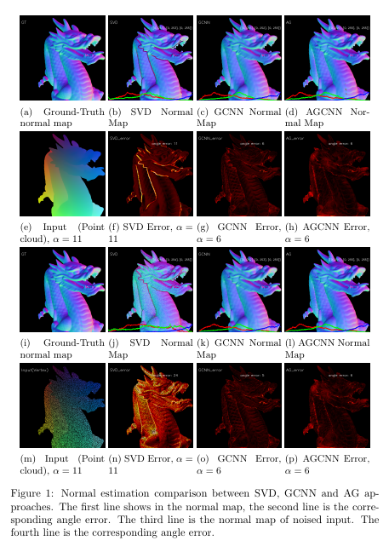
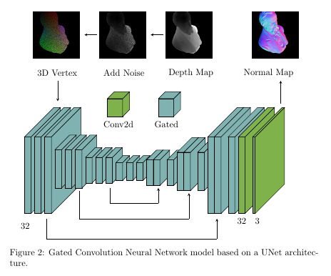
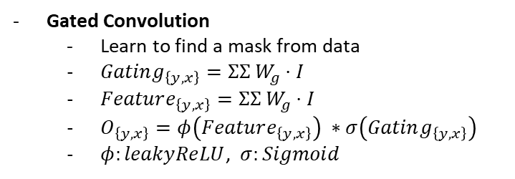
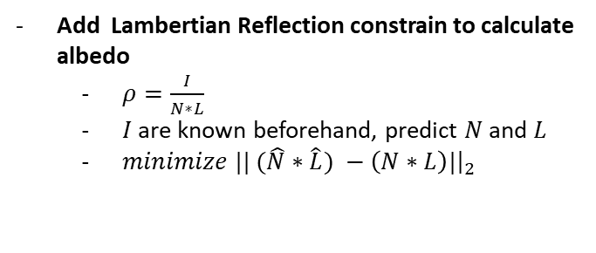
Gated Normal Neural Network (GNNN)
Gated Convolution
Learn to find a mask from data
$Gating_{\left\{y,x\right\}}=ΣΣ W_{g}⋅I$
$Feature_{\left\{y,x\right\}}=ΣΣ{ W}_{g}⋅I$
$O_{\left\{y,x\right\}}=φ\left(Feature_{\left\{y,x\right\}}\right) ∗σ\left(Gating_{\left\{y,x\right\}}\right)$
$φ:leakyReLU$, $σ:Sigmoid$
Add Lambertian Reflection constrain to calculate albedo
$ρ=\frac{I}{N∗L}$
$I$are known beforehand, predict $N$ and $L$
$minimize || (\hat{N}∗\hat{L}) −\left(N∗L\right)|{\left.​\right|}_{2}$
Down-sampling
Up-sampling
Notes:
Skip connections: Propagate detailed color or texture information to the decoder of that region

Slide 5
output
Sigmoid
LeakyReLU
Conv2D
Conv2D
input
Gated Convolution

Slide 6
Point cloud | Point Num
Apoll | 145K
Arm | 72K
Armadillo | 173K
Beared-guy | 1 millions

Slide 7
X
u
Z
f

Slide 8
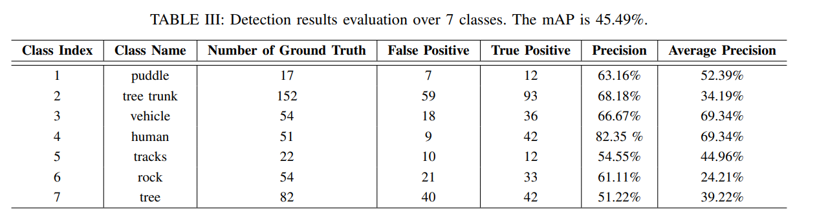
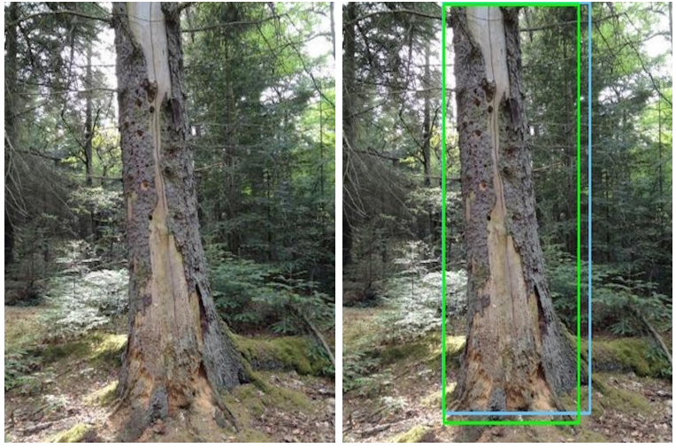
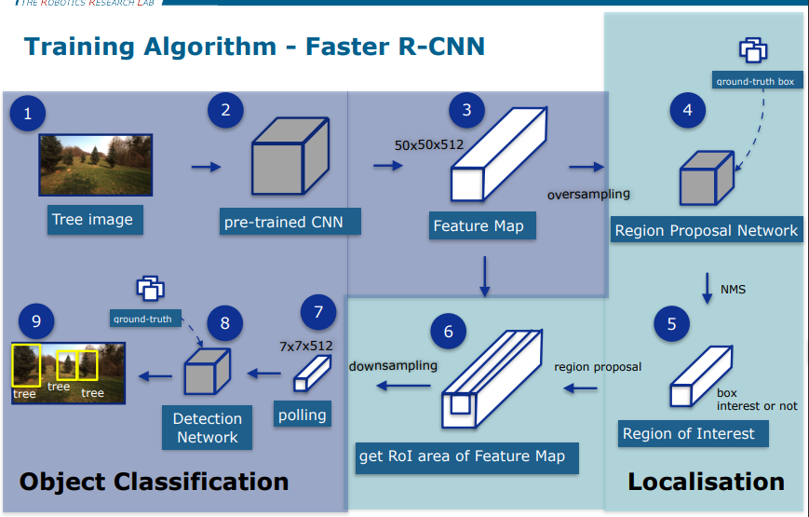
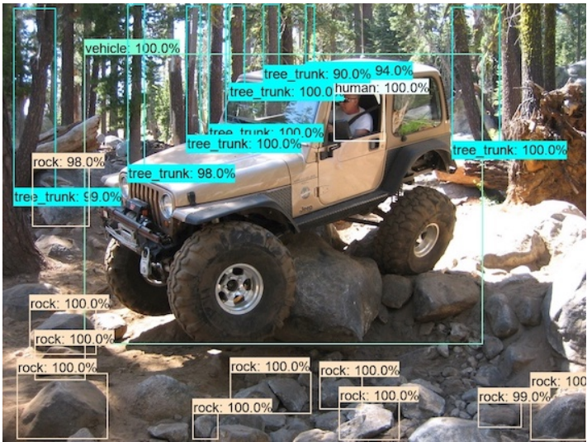
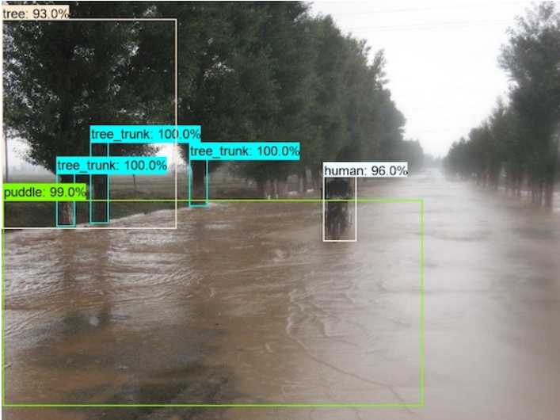
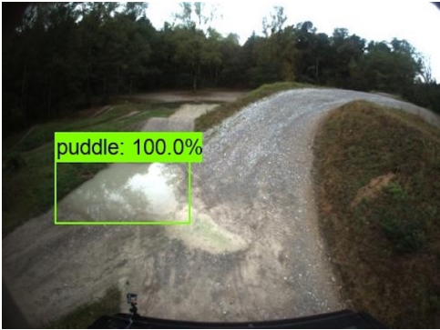
Project: Object Detection

Slide 9
FUTURE WORKS: Neuro-Symbolic AI
Scene detection
Trees -> outdoors
Rocks everywhere -> jungle
Inference
Who is driving the vehicle?
Does this human need help?

Slide 10
Thank you!

Slide 11
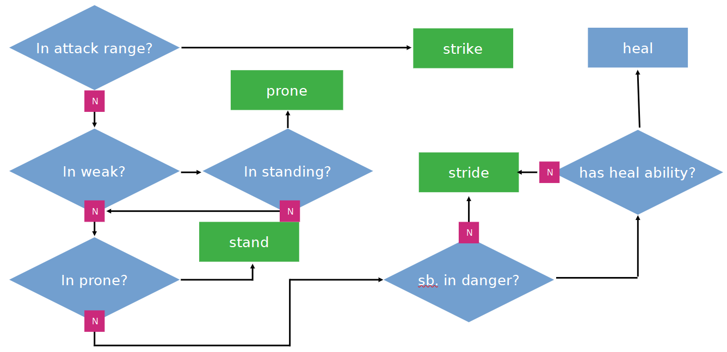
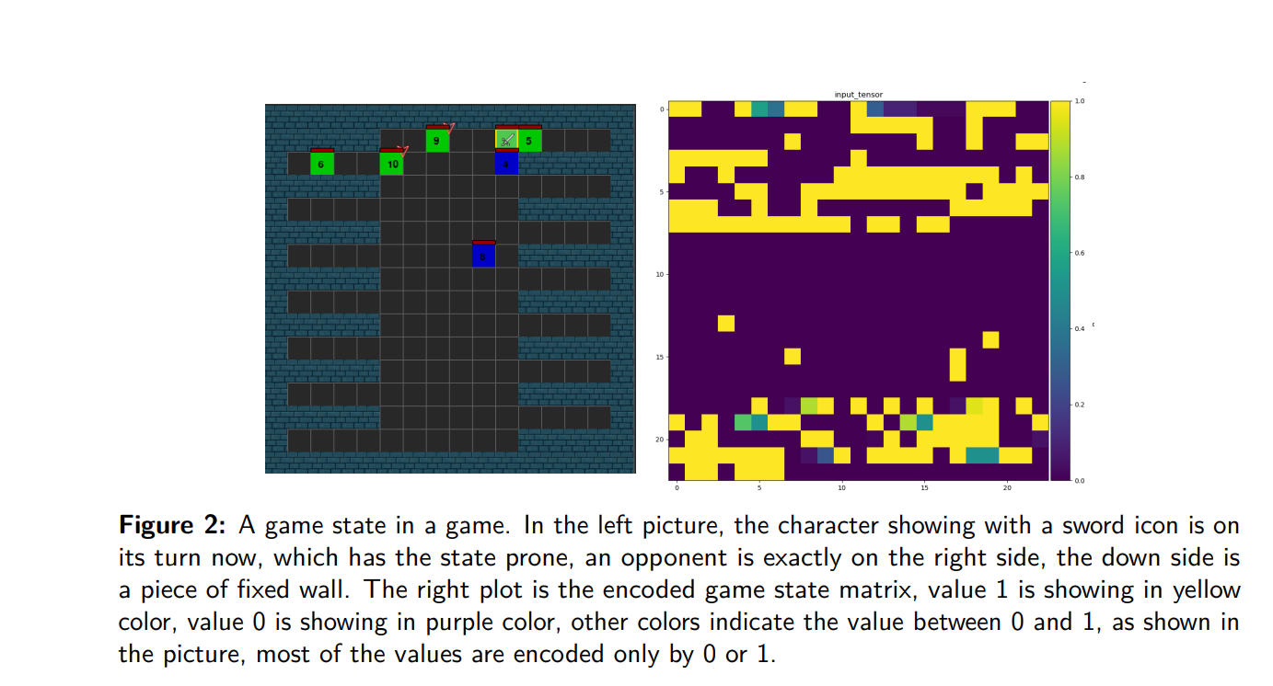
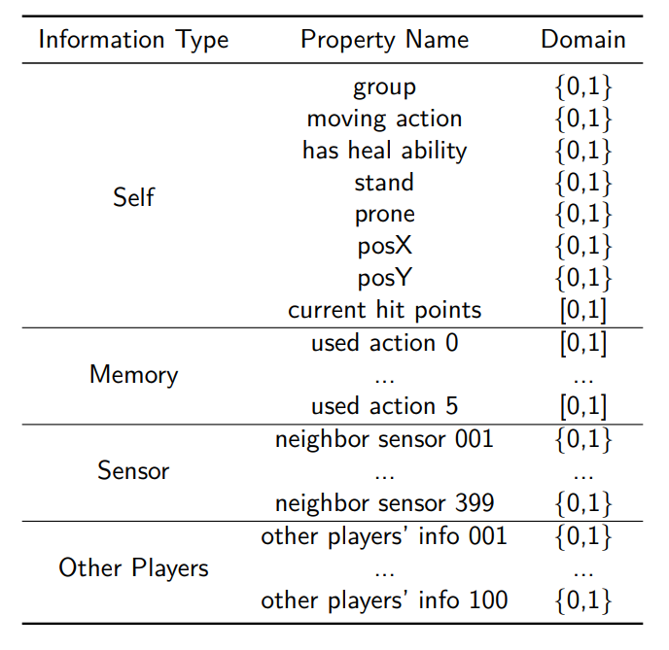
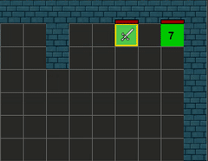
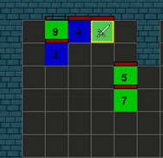
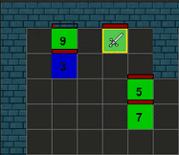
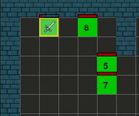
Project: RPG Game AI
End
Start

Slide 12
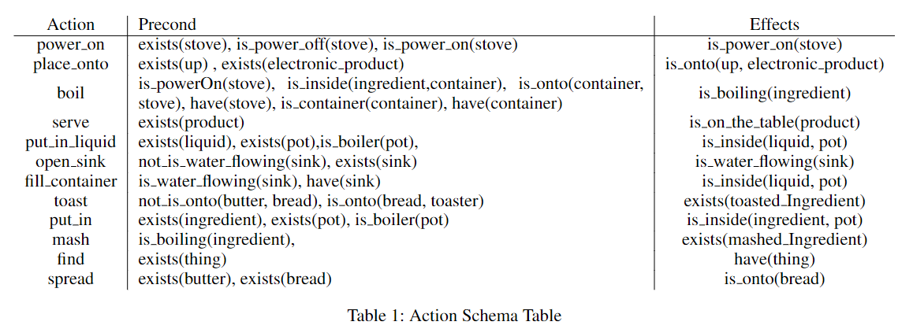
Project: Sandwich Recipes Planner

